Slide 1
Apache Kafka
JAVA SAMPLE PROJECT

Slide 2
POM
Add your Kafka dependencies to your Java project in your POM file.
You have two dependencies for this.
For Kafka, you need a specific version of Kafka Client, which you can download from here. You need 2.0.x Version.
The second dependency is for logging. You can use SLF4J Simple version 1.7.25 for this course.
Update your dependencies in maven and you are ready for some coding.

Slide 3
Producer with Callbacks
Create producer properties (Refer this documentation)
Create producer
Create bunch of messages
Send data (with callback option)
Flush and close producer
Receive via terminal consumer
The messages are not ordered as there are no keys

Slide 4
Simple Consumer Groups
Create consumer properties (Refer this documentation)
Create consumer
Poll for messages
Read data from beginning
Display received messages (reads by partition numbers)
Produce some new messages with earlier messages
See new messages consumed

Slide 5
Threaded Consumers/AssignAndSeek
Threaded Consumer
Create a Runnable Consumer
Use this to consume messages
Exit gracefully on shutdown, with proper clean-up
Assign and Seek
Don’t need the group Id
Directly read from a topic, partition & specific offset
Used for replay or fetch a specific message (perhaps vehicle route replay)

Slide 6
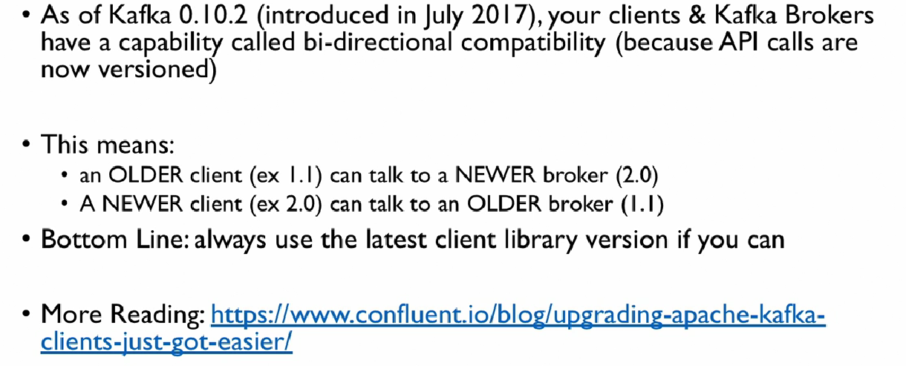
Bi-directional Compatibility

